Slide 1


Process Migration in Distributed Operating Systems
CSA-0437-Operating Systems for virtual machine
Supervisor
Dr. S. John Justin Thangaraj
Dr. Santhakumar D
Department of CSE
Presented by
R.Asif (192411163)
Ch.Venkata Karthik (192411209)

Slide 2
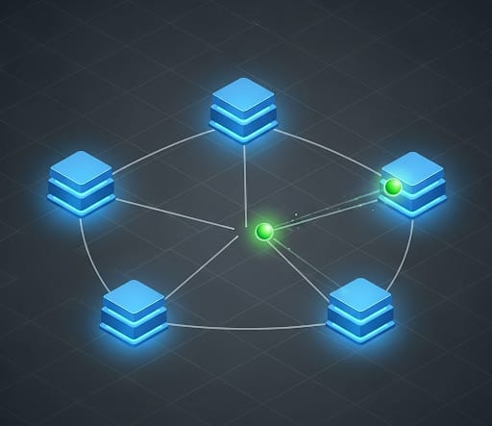
INTRODUCTION
A Distributed Operating System (DOS) connects many computers and makes them work like one system.
Sometimes one computer becomes very busy and another computer is idle.
Process Migration means moving a running task from one computer to another computer.
This helps the system work faster and more efficiently.
It improves resource usage and performance.

Slide 3
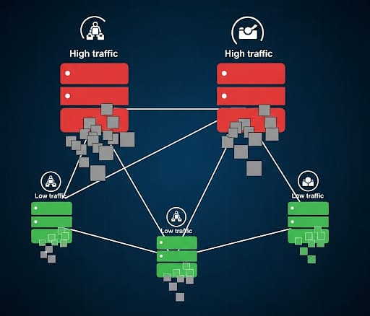
PROBLEM STATEMENT
In distributed systems, tasks are not equally distributed.
Some computers become overloaded.
Some computers stay idle.
Because of this:
Tasks take more time to finish
System efficiency becomes low
Resources are wasted
Goal: Move tasks from busy nodes → free nodes.
OBJECTIVES:
Balance the workload across all computers
Improve system performance
Reduce task completion time
Use resources efficiently
Avoid overloaded nodes

Slide 4
Module 1: Load Monitoring & Detection Module
Continuously monitors CPU usage of all nodes in the distributed system.
Detects overloaded nodes and underutilized nodes.
Collects system metrics such as CPU load, process count, and resource usage.
Identifies load imbalance situations in the network.
Sends the load information to the migration decision module.
Balance the workload across all computers
Improve system performance
Reduce task completion time
Use resources efficiently
Avoid overloaded nodes

Slide 5
Module 2: Process Migration & Allocation Module
Selects suitable processes from overloaded nodes.
Finds the best underloaded destination node.
Transfers the process state and memory to the selected node.
Resumes the process execution on the new node.
Ensures balanced workload and improved system performance.

Slide 6

CONCLUSION
Dynamic process migration improves distributed system efficiency.
Our simulation shows:
Balanced resource usage across nodes
Faster task completion
Low migration overhead relative to performance improvement
Suitable for cloud computing, clusters, data centres

Slide 7
REFERENCES
Zhang, Z., & Wang, C. (2025). Service Function Chain Migration: A Survey. Computers.
Maldonado Carrascosa, F. J., Seddiki, D., Jiménez Sánchez, A., et al. (2024). Multi-objective optimization of virtual machine migration among cloud data centers. Soft Computing.
Haris, R. M., Barhamgi, M., Nhlabatsi, A., et al. (2024). Optimizing pre-copy live virtual machine migration in cloud computing using machine learning-based prediction model. Computing.
Albalawi, N. S. (2025). Dynamic scheduling strategies for cloud-based load balancing in parallel and distributed systems. Journal of Cloud Computing.
Altahat, M. A., Daradkeh, T., & Agarwal, A. (2025). Virtual machine scheduling and migration management across multi-cloud data centers: blockchain-based versus centralized frameworks. Journal of Cloud Computing.

Slide 8
Thank You!

